Slide 1

Instrument Data Processing
MMR July 2020
AMMOS Technology
Jack Lightholder

Slide 2
Instrument Data Processing (CODEX)
Schedule
ID | WBS | CAM | Task Name | % Complete | Duration | Planned Start | Actual Start | Finished
375 | 05.01.13 | JLightholder | CODEX - Complex Data Explorer | 75% | 224 d | Tue 10/1/19 | Tue 10/1/19 | Fri 9/25/20
376 | 05.01.13 | JLightholder | Design and Implement "Data Quality Scan" User Interface | 100% | 62 d | Tue 10/1/19 | Tue 10/1/19 | 12/31/19
377 | 05.01.13 | JLightholder | Feature Bar Extension to Support Multiple Interaction Windows | 100% | 40 d | Thu 1/2/20 | 1/2/20 | 2/28/20
378 | 05.01.13 | JLightholder | Extend Server Data Reader Capabilities to for Additional Data Types | 100% | 33 d | Mon 3/2/20 | 3/1/20 | 4/15/20
379 | 05.01.13 | JLightholder | Extend Runtime Prediction Model to Support Features/Samples in Calculation | 100% | 22 d | Thu 4/16/20 | 3/1/20 | 3/15/20
380 | 05.01.13 | JLightholder | Design and Implement "Model Training" User Interface | 100% | 20 d | 3/15/20 | 3/15/20 | 4/1/20
381 | 05.01.13 | JLightholder | Enable Session Saving / Loading | 100% | 33 d | Tue 6/16/20 | NA | 7/1/20
382 | 05.01.13 | JLightholder | Enable Data / Code / Selection / Feature Export | 100% | 17 d | Mon 8/3/20 | NA | 7/12/20
383 | 05.01.13 | JLightholder | Advanced User Guidance Through Dynamic Error Reporting | 5% | 22 d | Wed 8/26/20 | NA

Slide 3
CODEX
Data Provenance Tracking
Track how data got created
Which algorithm was used?
What were it’s settings?
Which existing features were used to create it?
Visualize metadata on screen for user decision making and make this information exportable for future analysis.
Allow users to group collections of features for future group-usage.
Keep things together which were processed together
Machine learning grouping of features which correlate to one another.

Slide 4
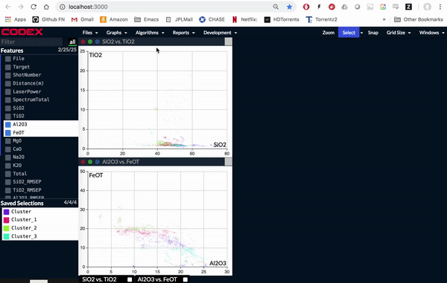
CODEX
Large Dataset Support – Work With Any Size of Data
Implemented an audit layer inside client and server for future debugging
Improved information transfer between the client and server for a more responsive user experience
No longer capped by larger datasets
Downsample to fit the needs of front end client the user is utilizing
Faster plot loading times by moving the data storage outside of the client data manager.

Slide 5
CODEX
Infusion Status
SDDA User Testing and MSL Infusion Program
Provide MSL operations teams with a suite of supporting data science programs and quantify improvements to their workflow
Validating gap analysis of the FY19 SDDA report
Program suite:
ORCHIDS – data alignment and re-gridding to make data ingestable by all downstream products.
TelemAnom – semi-supervised anomaly detection. Provides focus of attention tool for which time regions operators might be interested in.
RAVEN – large scale data visualization dashboard. Allows operators to view large time/feature regions to further isolate data of interest
CODEX – deeper analysis support on isolate data set. Allows mission operators to conduct a deeper analysis on isolated data and isolate cause/effect.
Conducting user studies with 10 MSL team members.
Strategic data analysis – answer questions with low resolution data across a large time region
Tactical data analysis – answer questions with high resolution data across a short time region
Providing findings report too SDDA and MSL mission management

Slide 6
CODEX
Plans for Next Month
Mentoring intern project (faster data handling)
Conduct user studies with SDDA
Support ASTHROS telemetry analysis investigation
Open source release 3
Increased project documentation and ease of installation

Slide 7
CODEX
Financial Status
Complex Data Explorer
Actual YTD costs are $173K versus plan of $136K
Slowing down while team committed to M2020 deliverables
Could support additional funding with additional deliverables if available

Slide 8
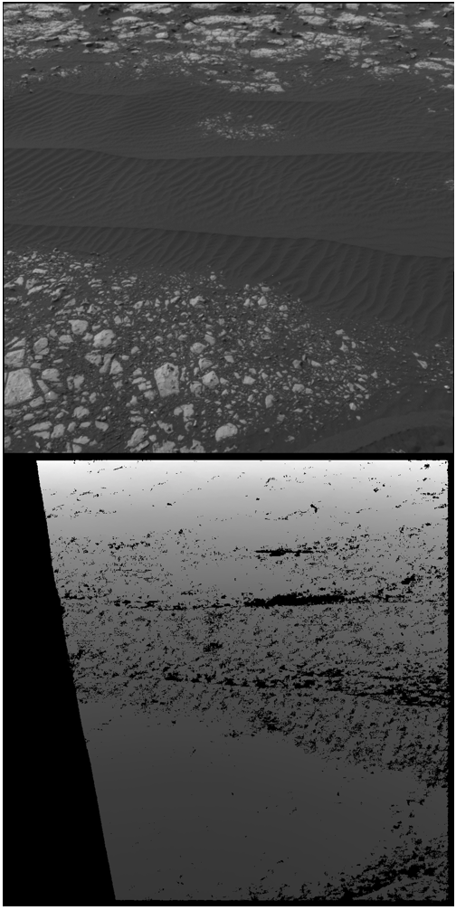
PATCH
Why?
Local 3D mapping needed for driving MSL
Depth recovered using stereophotogrammetry
Low contrast areas (sand) lead to uncertainties
Need complimentary method to fill hole

Slide 9
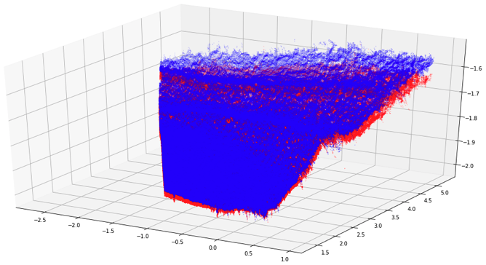
PATCH
What has been done?
Adapt photoclinometry work by Jiang et al. (2017) using CTX and MOLA
Built prototype platform using python
Rebuilt mathematical foundation to account for severe obliquity

Slide 10
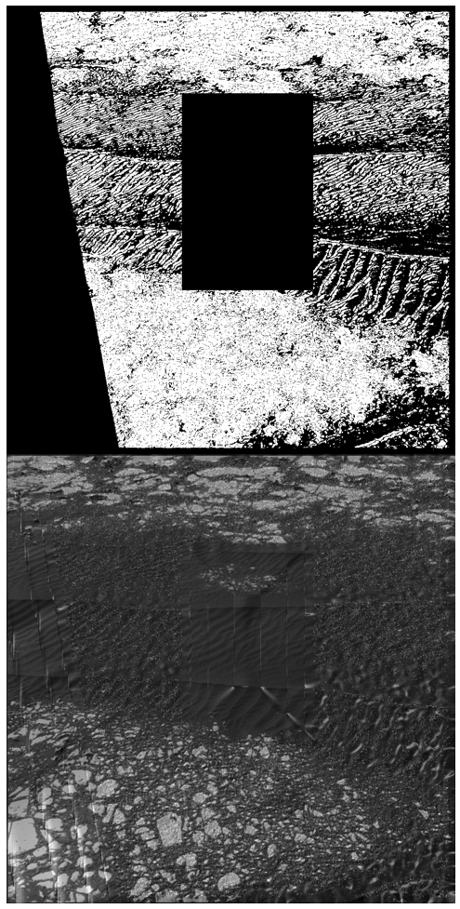

PATCH
State of work
Demonstrated stability and convergence (the big sine qua non)
Identified (lack of) uniqueness criteria

Slide 11
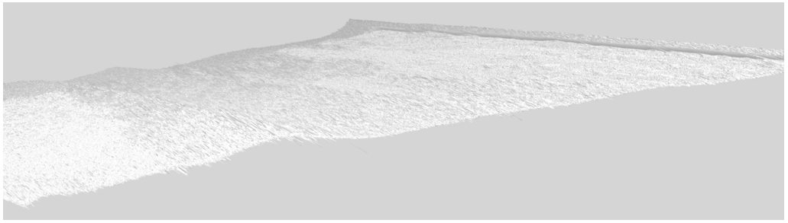
PATCH
Near future work outlook
Integrating algorithm within VICAR.

